Slide 1


Spotify
Song Popularity and Trend Analysis

Slide 2



Welcome
Upgrade
USER
Overview
Objectives
Project Overview
This project analyzes Spotify's top songs by examining streaming trends, popularity metrics, and social media mentions over 16 weeks. It integrates time series forecasting and machine learning to predict future trends and understand relationships between features.
Our Teams
Dataset
Methodology
Achievements
SARIMA
Gallery
Play
Follow
Future Scope
Conclusion

Slide 3


Upgrade
USER
Overview
Objectives
Objectives
Our Teams
Dataset
Methodology
The objectives of this project includes analysing stream counts and social media trends for top 1000 songs.
Forecasting future streams using SARIMAX model.
Explore relationships between features such as loudness, energy, and danceability using linear regression.
Visualize data insights through static and interactive plots for better understanding.
Achievements
SARIMA
Gallery
Future Scope
Conclusion

Slide 4

Upgrade
USER
Overview
Objectives
Our Teams
Dataset Description
Dataset
Methodology
Achievements
#
Title
Description
SARIMA
1
Popularity
A static measure for each song across all weeks.
2
Social Media Mentions
The number of mentions of songs over 16 weeks
Gallery
Future Scope
3
Weeks 1-16
Weekly streaming counts for each song over 16 weeks
Conclusion
4
Track Name / Artist Name
Track Name and Artist Name for better filtering
5
Additional Features
Danceability, energy, loudness, key, acousticness, and more

Slide 5
Upgrade
USER
Overview
Objectives
Methodology
Our Teams
Dataset
Methodology
Achievements
01
Data Collection
04
SARIMA
SARIMA
Gallery
02
Preprocessing
05
Linear Regression
Future Scope
Conclusion
03
Feature Relationship
06
Visualizations

Slide 6
Project Flow
Data Collection: Fetched the top 1000 songs data from Spotify API. Social Media Mentions were fetched from Twitter API.
Preprocessing: Handled missing values (replacing with mean), standardized some features, reshaped the data to fit time series format.
Feature Relationship: Identify the important features which are related to get better predictions.
SARIMAX: keeping popularity exogeneous, and seasonal order (1,1,1,4) since we have 4 months data, and later generate plots.
Linear Regression: Split data into 70/30. Target variable is social media mentions. Plotted actual vs predicted graph.
Visualizations: Include heatmap, residual distribution plot, time-series plots, etc.

Slide 7
Upgrade
USER
Overview
Achievements
Objectives
Our Teams
Performance metrics
Dataset
Methodology
Achievements
SARIMA
957.16
0.95
15+
Gallery
Future Scope
MAE
R² Score
Conclusion

Slide 8




Upgrade
USER
Why SARIMA?
Overview
Objectives
We use SARIMA model for the following reasons: 1. It exhibits seasonal trends in music popularity, i.e., change in stream count over weekly releases, seasonal events (festivals), and quarterly music industry cycles, allowing for seasonal decomposition of the data. 2. It allows us to predict future trends based on the historical data.
3. Parameters (p,d,q,m) allow for customization allowing seasonal pattern capturing, accounting for weekly variations and robust forecasting.
4. Provides us with better predictive capability by accounting for external features that influence the time series.
Our Teams
Dataset
Methodology
Seasonal Trend
Variations
Achievements
SARIMA
Gallery
Prediction
Time Series
Future Scope
Conclusion

Slide 9
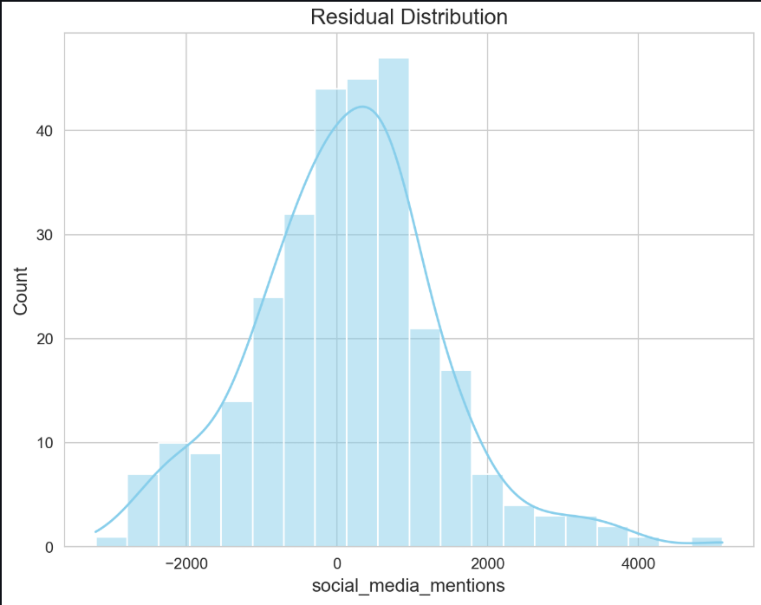
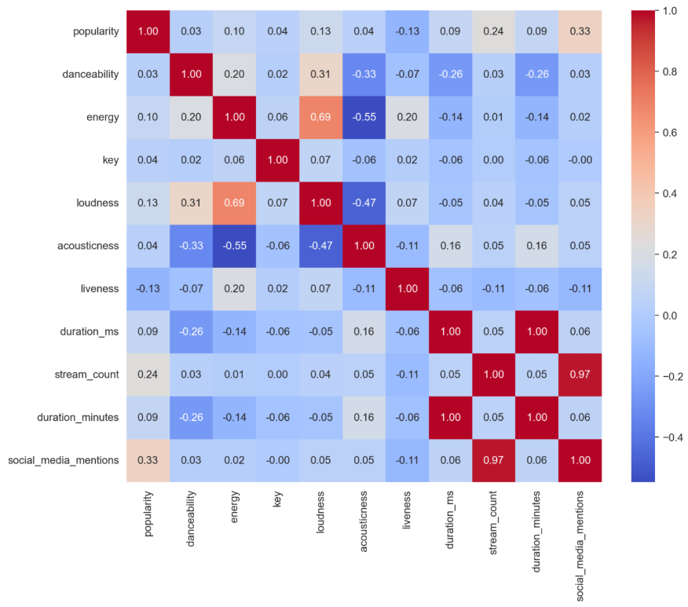
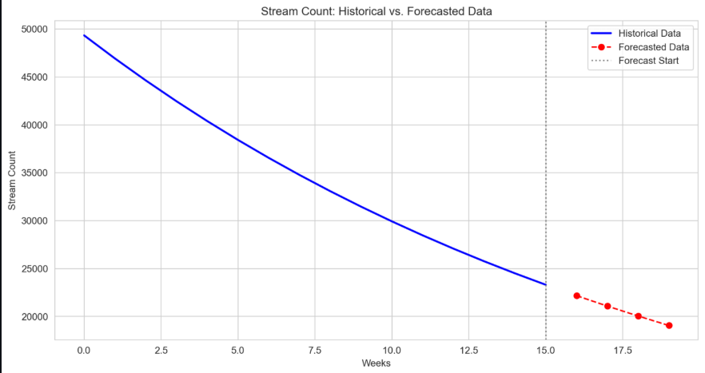
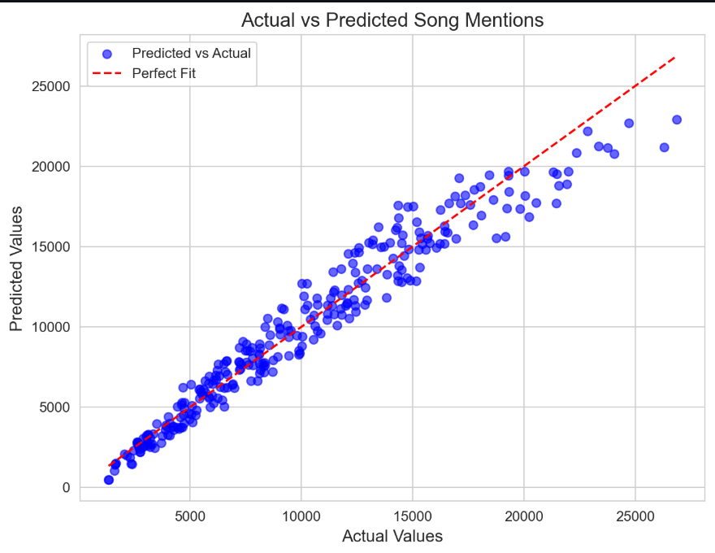
Upgrade
USER
Overview
Plots
Objectives
Our Teams
Dataset
Methodology
Achievements
SARIMA
Gallery
Future Scope
Conclusion

Slide 10
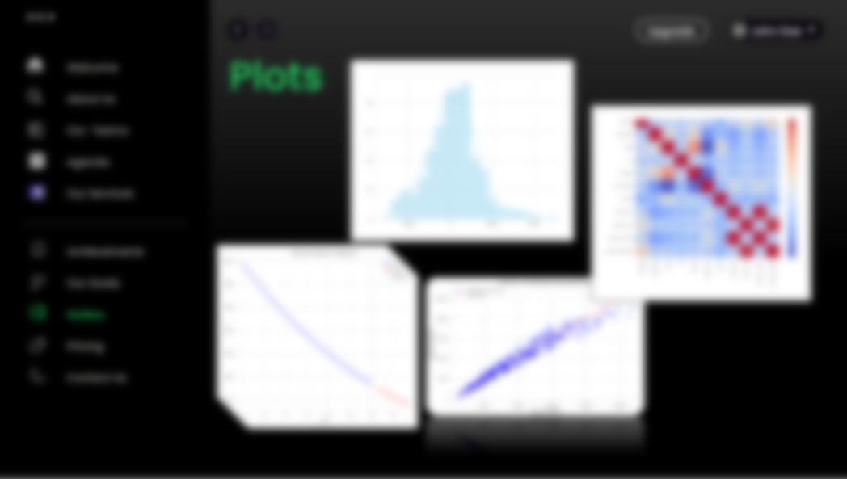

Slide 14
Upgrade
USER
Overview
Plots
Objectives
Our Teams
Dataset
Methodology
Achievements
SARIMA
Gallery
Future Scope
Conclusion

Slide 15

Upgrade
USER
Overview
Objectives
Our Teams
Future Scope
Dataset
Methodology
Enhanced Predictive Models: We can incorporate broader range of features including genre-specific attributes and develop more granular predictive models for different music categories.
Real-time Analysis: We can implement real-time analysis of song popularity using sentiment analysis. Expand Data Source: We can gather information from different streaming platforms to analyze song popularity and trends.
Also, this analysis can be used in the yearly Spotify wrapped to get more personalized results, as it is based on the user history. It’s a good example where time series data is used.
Achievements
SARIMA
Gallery
Future Scope
Conclusion

Slide 16

Upgrade
USER
Conclusion
Overview
Objectives
We successfully processed the data on features such as streaming counts, social media mentions, and implemented SARIMAX time series forecasting enabling more accurate predictions of song popularity trends.
We used linear regression to explore correlations between various song features such as danceability, energy, and loudness, uncovering important relationships that influence song popularity and used heatmaps, scatter plots, and time-series plots to present complex data in an intuitive and accessible manner.
Our Teams
Dataset
Methodology
Achievements
Spotify
SARIMA
Gallery
Future Scope
Conclusion
@spotifyofficial

Slide 17
References
Google.com
Kaggle Dataset: https://www.kaggle.com/datasets/edalrami/19000-spotify-songs
Spotify API
Twitter API

Slide 18



Thank You
The Plan (TENET)
Travis Scott
0:23
-3:25

